Slide 1

CSC 102 Final Project Presentation
Justin Gaalswijk, Joshua Tucker and Joey Parsons

Slide 2

How we did it?
Worked on it during class, sometimes a bit after
Met up on Tuesdays to do more work
Split up tasks but still helped each other
Notes:
Joey

Slide 3

What could we have done better?
Enhance the GUI beyond the black screen and text
More variety to phases
Notes:
Justin

Slide 4
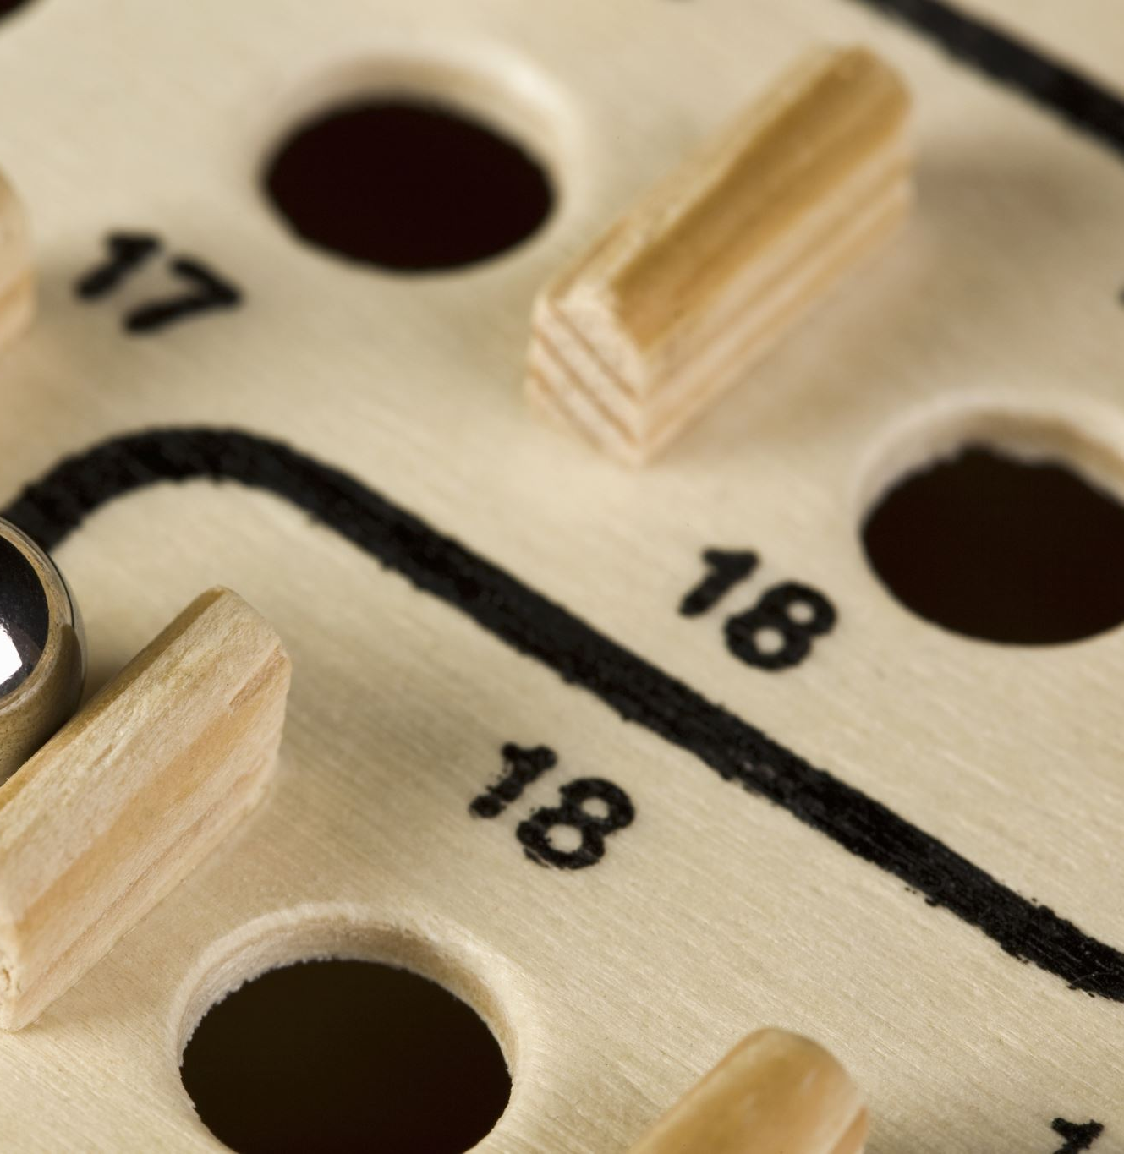
How does the bomb work?
This bomb game uses a countdown timer and LCD interface where you have to defuse four separate components which include keypad, wires, button, and toggles before time runs out or you make too many mistakes. Each part runs on its own in the background, constantly checking for your input through the Raspberry Pi’s connected components. The main program keeps everything in sync, updating the screen as you progress and keeping track of your strikes and time left.
Notes:
Joshua

Slide 5
What have we learnt?
Collaborative programming and version tracking with GitHub
Running multiple parts of a program at once via threading
Working on programs that use multiple .py files
Notes:
Joey

Slide 6
What have we learnt? - Raspberry Pi
Programming and handling the Raspberry Pi device itself
Input/Output with the Breadboard Connections
Sending physical input such as bomb defusal devices to the RPi
Notes:
Justin

Slide 7
What have we learnt? - Tkinter
Creating and manipulating a GUI
Adding Buttons to the GUI - Pause, Quit, Retry
Accurately receiving input from the breadboard/RPi and displaying it on the GUI
Notes:
Joshua

